Slide 1
Low Power Optimization for EMBEDDED CompilerS
Submitted by:
D. Rajeswar Rao IIT2014055
Saurabh Tanwar IIT2014140
Sachin Agarwal IIT2014501
Nishit Gupta IIT2014502
Project Supervisor
Dr. Bibhas Ghoshal

Slide 2
MOTIVATION
The present focus of Compiler Optimization techniques is reducing the “Execution Time” of the program.
With the advancement in technology, portable devices, embedded systems etc. are being widely developed which are handy and easy to use.
These portable devices are battery powered.
Along with performance, the power consumption also needs to be looked at i.e. we need devices which should consume less power along with generating output faster.
Therefore, the idea of Low Power Optimization.

Slide 3
Energy has become an important design consideration, together with performance in computer systems.
While hardware optimizations has been the focus of several studies and are fairly mature, software approaches to optimizing power are relatively new.
Progress in understanding the impact of traditional compiler optimizations and developing new power-aware compiler optimizations are important to overall system energy optimization.
Here we focus on two questions?
Is the most efficient code from Execution Time perspective same as that for the Energy viewpoint?
If not, then what are the Power-Aware Optimization Techniques?

Slide 4
OBJECTIVE
To conduct a survey and find the result of Current Optimization Techniques on Performance and Power.
Study various Power-aware Optimization Techniques.
With the Knowledge of these Techniques, develop a patch that could reduce Power and compare it with the present Optimization Techniques.

Slide 5
TARGETS ACHIEVED
Survey successfully completed.
Conclusion :
“Power Optimization is not a by product of Performance Optimization”
i.e. with the use of current Optimization Techniques which aim primarily on Performance, Power does not get optimized along with it.
Studied Different Power-aware Optimization Techniques.
Reducing Instruction Count.
Tuning Memory Optimizations.
Reducing Switching.
Instruction Scheduling etc.
Developed a Pass using LLVM.
Conclusion :
Power reduced.

Slide 6
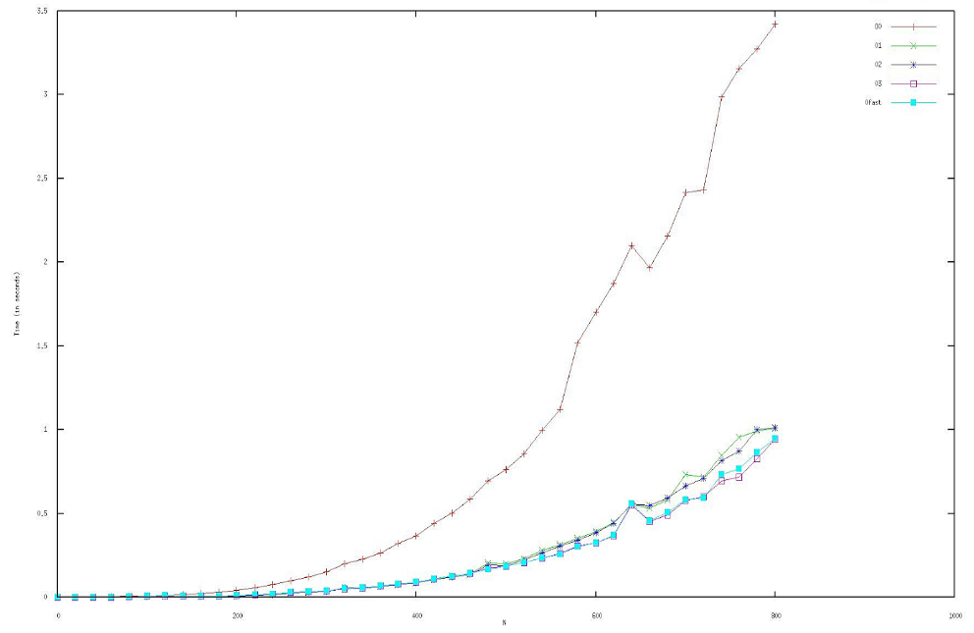
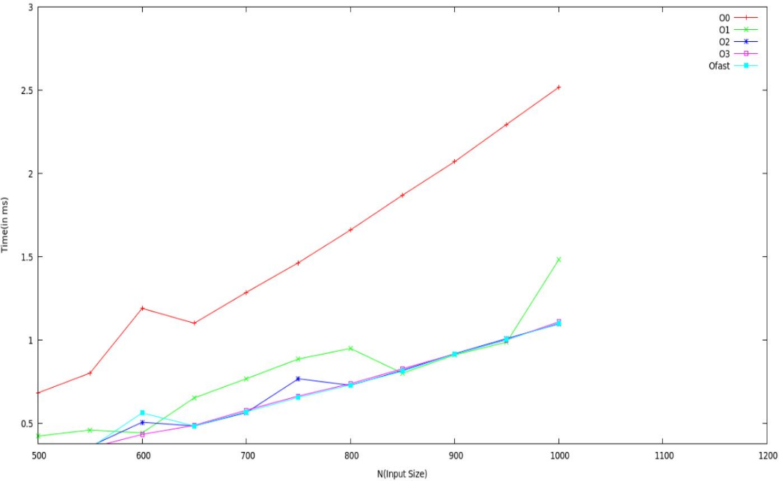
METHODOLOGICAL STEPS
Survey (First Phase)
Used a Matrix Multiplication code [Running Time – O(n³)] and Bubble Sort code [Running Time – O(n²)]
Compiled it with different Optimization Levels – Oo,O1,O2,O3 and Ofast using the GCC Compiler.
Using the command: gcc –Ox matrix_mult.c
gcc –Ox bubble_sort.c
Plotted a curve for Execution Time for different values of n and also various Optimization Levels using GNUPlot.
Matrix Multiplication
Bubble Sort

Slide 7
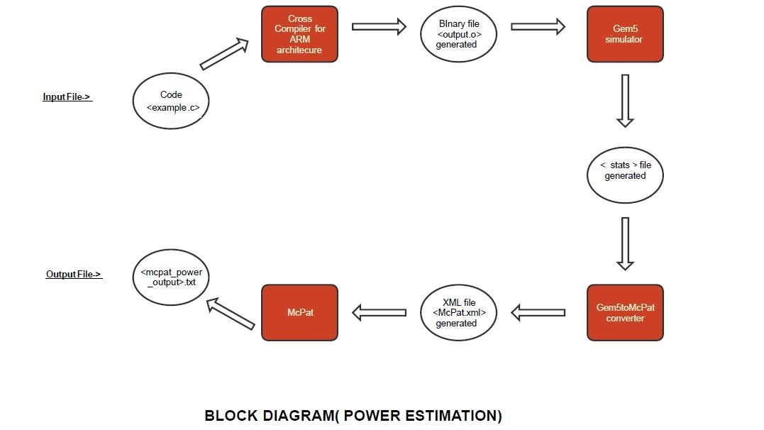
Calculated Power Consumed using the following procedure:
n | O0 | O1 | O2 | O3 | Ofast
200 | 522.784mW | 570.949mW | 571.1mW | 571.1mW | 571.1mW
400 | 511.355mW | 517.956mW | 517.966mW | 517.966mW | 517.966mW
Matrix Multiplication Power Consumption
n | O0 | O1 | O2 | O3 | Ofast
1000 | 513.232mW | 513.4996mW | 513.4996mW | 513.4997mW | 515.264mW
Bubble Sort Power Consumption

Slide 8
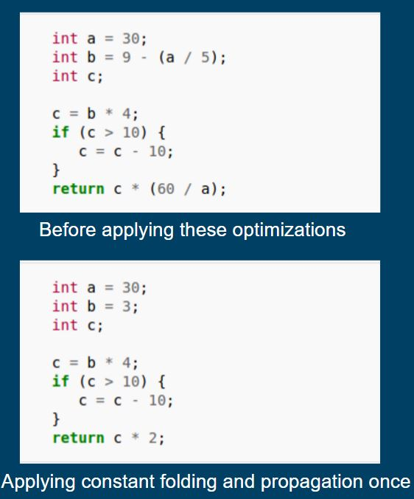
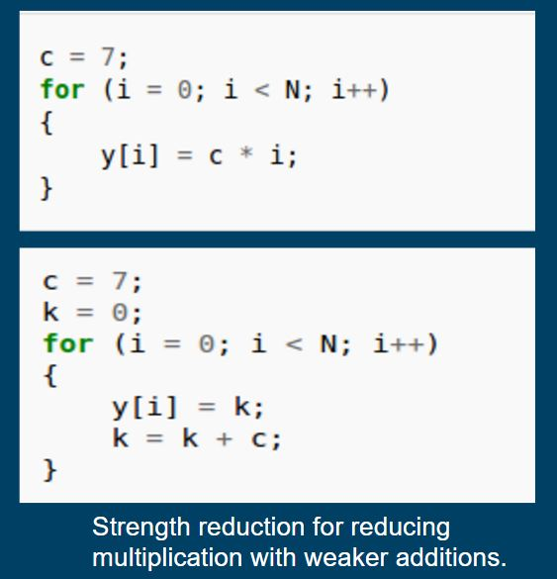
Power Reduction (Second Phase)
Various Power Optimization Techniques :
Reducing Instruction Count : Less no. of instructions directly imply less power.
Tuning Memory Optimizations : Replacing Memory References by Register References. It will save memory loads & stores. Also we can use Scalar replacement to reduce fetching of data from memory by making good use of Processor Registers.
Constant Folding and Constant Propagation :
Constant folding is the process of recognizing and evaluating constant expressions at
compile time rather than computing them at runtime.
Constant propagation is the process of substituting the values of known constants in expressions
at compile time.
Strength Reduction : Strength reduction is a compiler
optimization where expensive operations are replaced with
equivalent but less expensive operations.

Slide 9
Making of Power Optimization Pass (Patch)
Requires the Use of LLVM and CLANG
LLVM compiler infrastructure project (formerly Low Level Virtual Machine) is a "collection of modular and reusable compiler and tool chain technologies" used to develop compiler front ends and back ends .
Allows modifications to be made to the intermediate code which is basically the application of Pass which user makes.
LLVM uses CLANG as Front-end, so we can use this front-end to avail the facilities of the LLVM Compiler Collection.
We will be writing a Pass for this LLVM compiler infrastructure .
What is an LLVM Pass?
Passes perform the transformations and optimizations that make up the compiler.
They build the analysis results that are used by these transformations, and they are, above all, a structuring technique for compiler code.
All LLVM passes are subclasses of the Pass class, which implement functionality by overriding virtual methods inherited from Pass.
LLVM Pass Framework is that it schedules passes to run in an efficient way based on the constraints that your pass meets.
What does our Pass do?
Our Pass minimises arithmetic instructions making use of the following identities:
x + 0 = 0 + x = x
x - 0 = x
0 - x = -x
x/x = 1
x * 1 = 1 * x = x
x/1= x
x * 0 = 0 * x = 0
i.e. We will check both the operands and the operator and if they satisfy the above mentioned conditions, then we will directly return the result without actually computing + , - , * or / thereby reducing the instructions to be executed and also a CPU-task.
It further uses the techniques of Constant Folding and Strength Reduction as discussed previously.

Slide 10
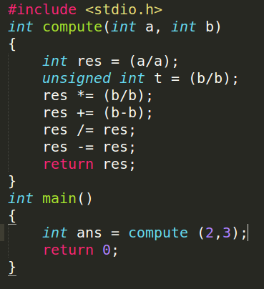
EXPLANATION OF OUR PASS
All the algebraic identities mentioned previously reduce the no. of instructions in the intermediate code.
Look at the following C code :
We will now see the effect of our pass on the above C code.
The pass will first apply Algebraic Reduction, Constant Folding followed by Constant Propagation.

Slide 11
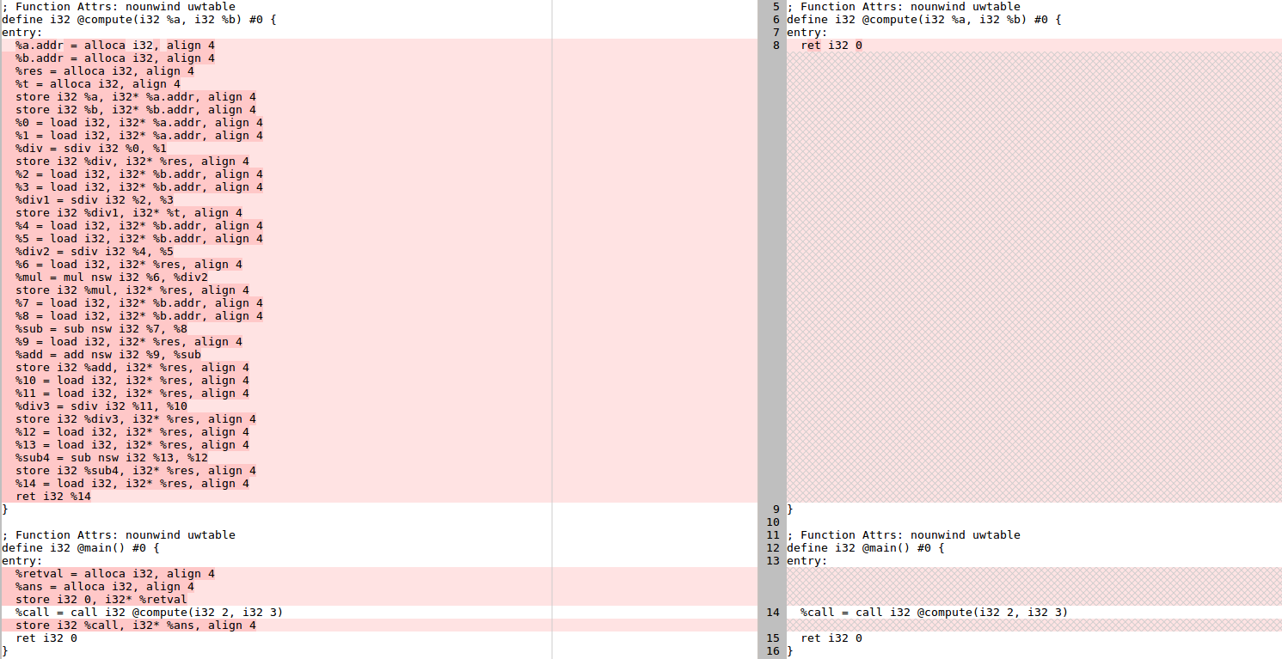
Intermediate Code before Intermediate Code after
applying Pass applying Pass

Slide 12
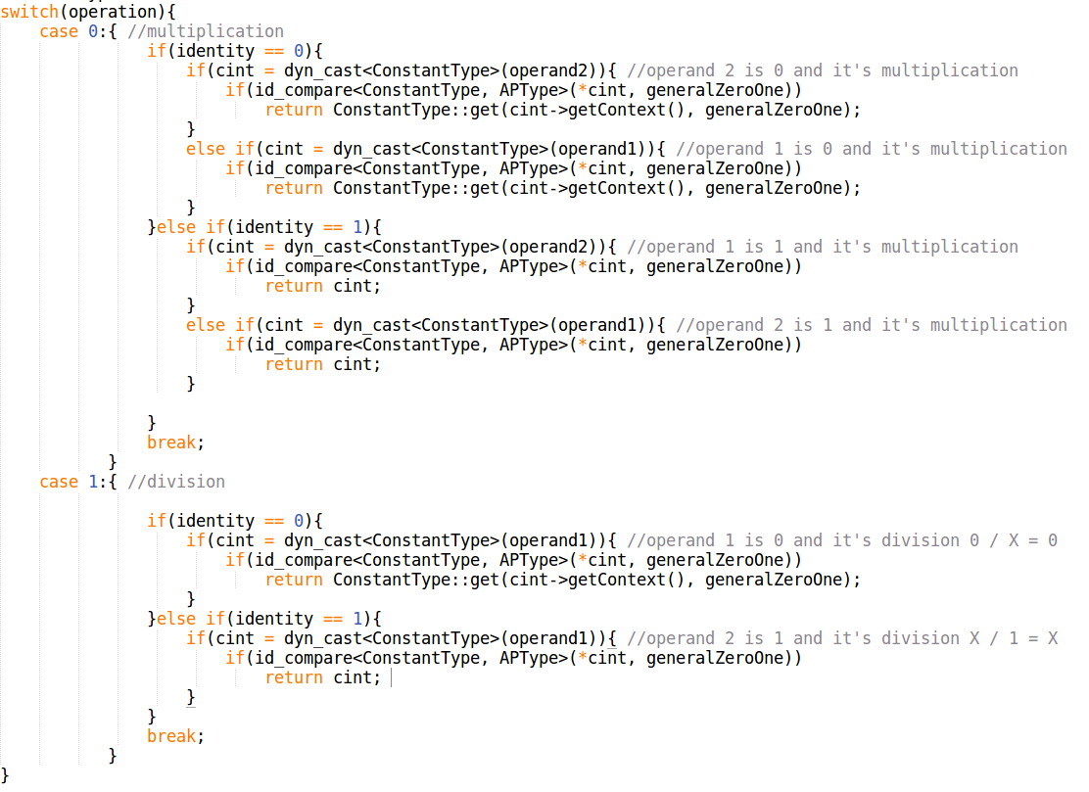
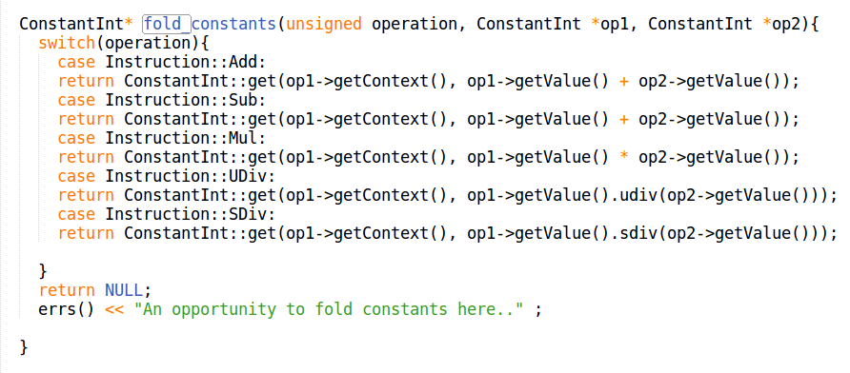
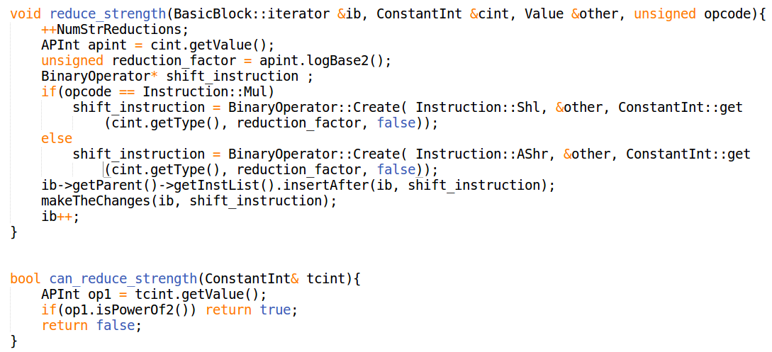
CODE SNIPPET

Slide 13
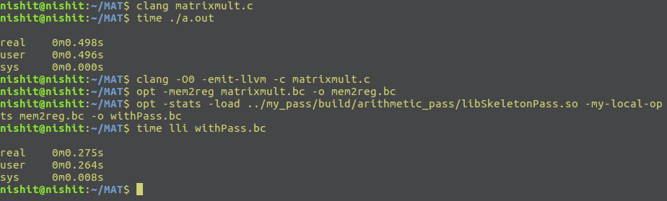
RESULTS
Execution Time
%Reduction for Execution Time = 44.7%
Power Consumption
WITHOUT PASS | WITH PASS
PROCESSOR | % Reduction = 22.13 %
Runtime Dynamic : 0.658171 W | Runtime Dynamic : 0.512492 W
CORE | % Reduction = 22.23 %
Runtime Dynamic : 0.658171 W | Runtime Dynamic : 0.511807 W

Slide 14
CONCLUSION & FUTURE SCOPE
FIRST PHASE
On the basis of execution time survey and power survey conducted , the conclusion was that the present optimization techniques merely focus on execution time reduction and not on power reduction.
Hence there is need to explore optimization techniques whose primary goal is to reduce power consumption .
SECOND PHASE
After going through various power optimization techniques, focus was to reduce instruction count mainly.
We implemented a pass which targeted constant folding and strength reduction optimizations and reducing algebraic operations thereby reducing instruction count and succeeded in reducing power as opposed to the increase in power consumption by previously existent optimization techniques.
This project can further be modified to include other power optimization techniques for other benchmarks like reducing number of loops, loop unrolling etc. which focus on power reduction.
If implemented in a skillful manner and on a broad scale, power reduction can pave a new way for the future by increased use of embedded system and battery-operated devices.

Slide 15
Thank You!

